Slide 1


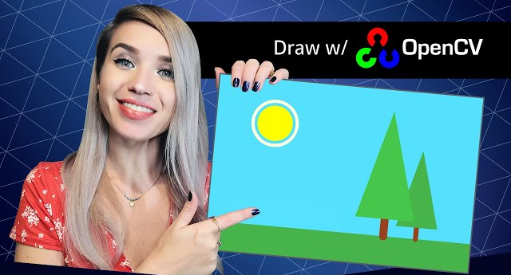
Session 7 :
Drawing on Images

Slide 2
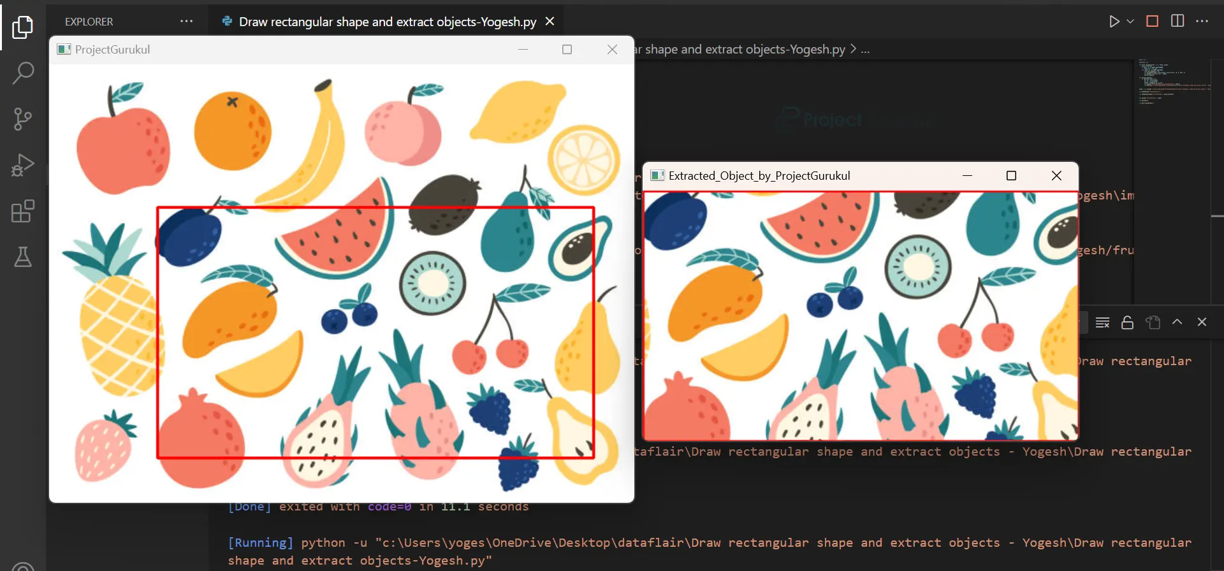
1. Why Draw on Images?
Make memes: Add text to funny photos!
Create posters: Highlight key parts of an image.
Label diagrams: Explain science projects or maps.

Slide 3
2. Basic Tools in OpenCV
Use these functions to draw on images:
Function | What It Does | Example
cv2.line() | Draws a straight line | Draw roads on a map.
cv2.rectangle() | Draws a rectangle | Highlight faces in a photo.
cv2.circle() | Draws a circle | Add emojis to a selfie.
cv2.putText() | Adds text | Create a meme caption.

Slide 4
1: Load an Image and draw shape
import cv2
# Load an image
image = cv2.imread("flower.jpg")
# Draw a red rectangle (BGR format: (0, 0, 255))
cv2.rectangle(image, (50, 50), (200, 200), (0, 0, 255), 3)
# Display the image
cv2.imshow("Image with Rectangle", image)
# Wait for a key press and close windows
cv2.waitKey(0)
cv2.destroyAllWindows()

Slide 5
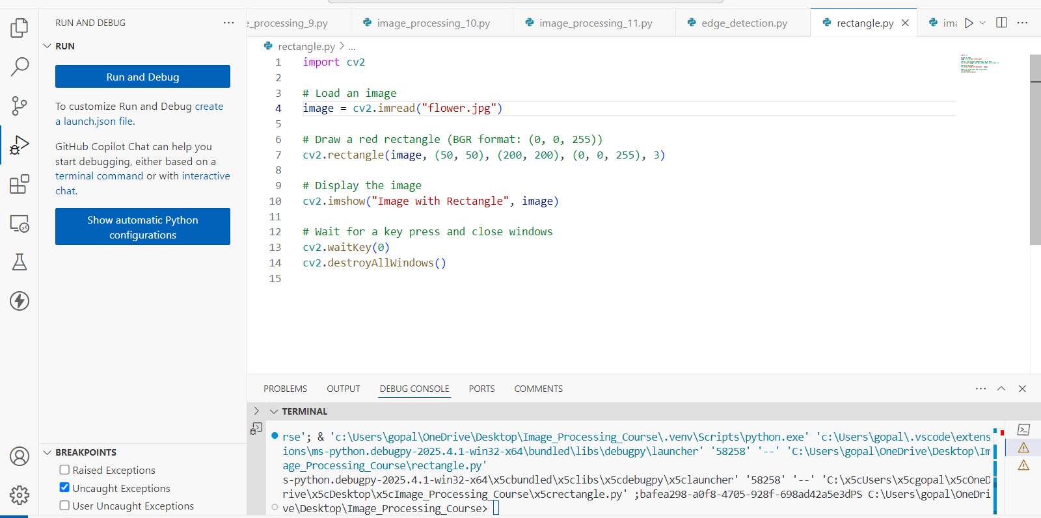

Slide 6
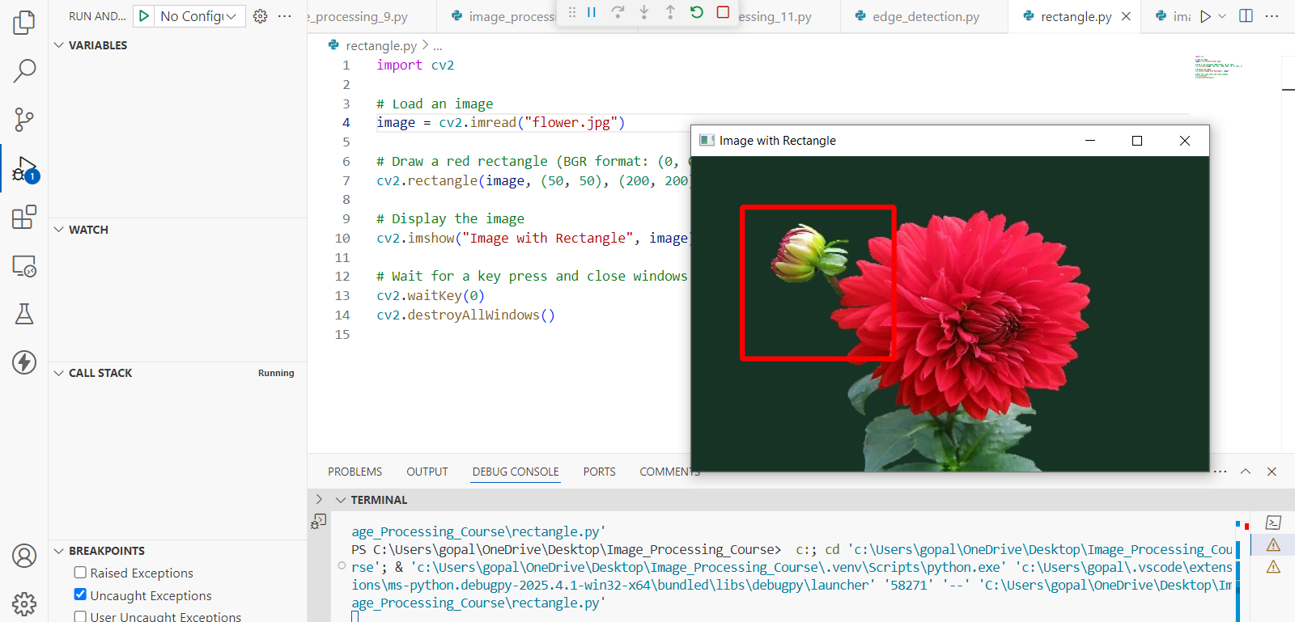

Slide 7
Draw a Green Circle
import cv2
# Load an image
image = cv2.imread("flower.jpg")
# cv2.circle(image, center, radius, color, thickness)
cv2.circle(image, (300, 100), 50, (0, 255, 0), -1) # -1 fills the circle!
# Display the image
cv2.imshow("Image with Rectangle", image)
# Wait for a key press and close windows
cv2.waitKey(0)
cv2.destroyAllWindows()

Slide 8


Slide 9
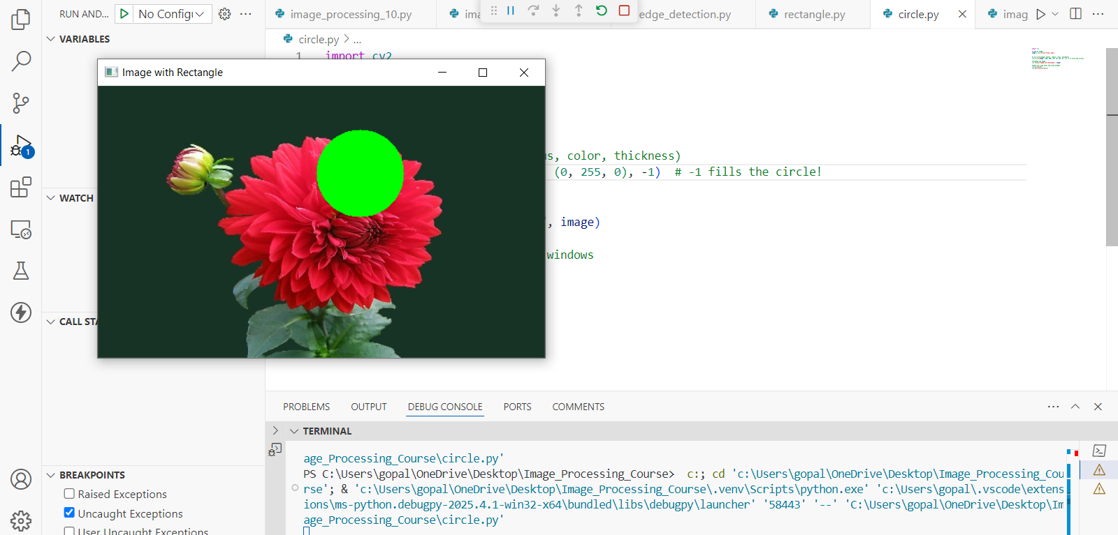
Draw a Green Circle

Slide 10
Draw a Green Circle
Add Line
import cv2
# Load an image (replace "flower.jpg" with your image file)
image = cv2.imread("flower.jpg")
# --- Draw Shapes ---
# Red line from top-left to bottom-right
cv2.line(image, (0, 0), (300, 300), (0, 0, 255), thickness=5)
# --- Display Results ---
cv2.imshow("Fun with Shapes!", image)
cv2.waitKey(0) # Press any key to close
cv2.destroyAllWindows()

Slide 11


Slide 12
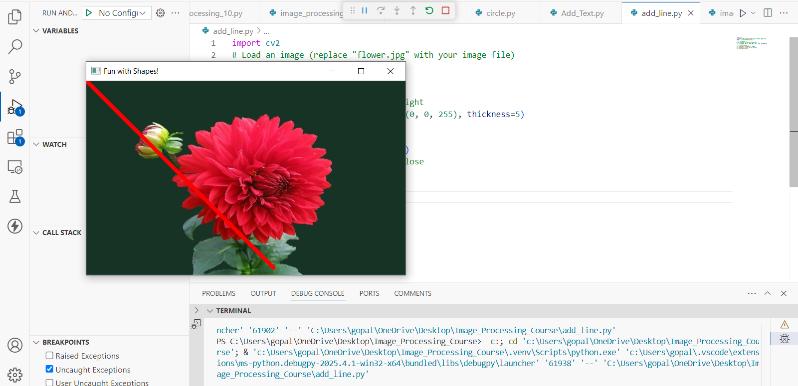
Draw a Red Line

Slide 13
Add Text
import cv2
# Load an image
image = cv2.imread("flower.jpg")
# cv2.putText(image, text, position, font, font_scale, color, thickness)
cv2.putText(image, "Hello World!", (50, 100), cv2.FONT_HERSHEY_SIMPLEX, 1, (255, 0, 0), 2)
# Display the image
cv2.imshow("Image with Rectangle", image)
# Wait for a key press and close windows
cv2.waitKey(0)
cv2.destroyAllWindows()

Slide 14


Slide 15
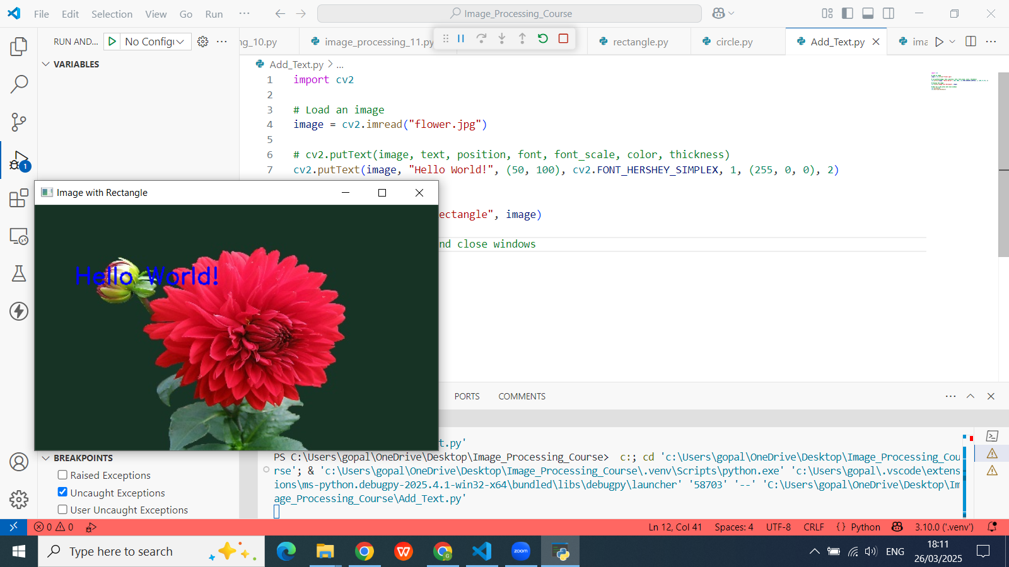
Write a Text in Blue

Slide 16
Exercise
1. Which OpenCV function is used to draw a rectangle on an image? A. cv2.drawRect() B. cv2.rectangle() C. cv2.box() D. cv2.drawBox()
Correct Answer: B. cv2.rectangle()
2. What does the color (0, 0, 255) represent in OpenCV? A. Blue B. Green C. Red D. Yellow
Correct Answer: C. Red (OpenCV uses BGR format)

Slide 17
Exercise
3. What value of thickness should be used in cv2.circle() to fill the circle completely? A. 0 B. -1 C. 1 D. None
Correct Answer: B. -1
4. What is the purpose of the function cv2.putText()? A. Add captions to a video B. Add a label to a graph C. Write text on an image D. Overlay watermark only
Correct Answer: C. Write text on an image

Slide 18
Exercise
5. In cv2.putText(), which font was used in the presentation example? A. cv2.FONT_HERSHEY_TRIPLEX B. cv2.FONT_HERSHEY_SIMPLEX C. cv2.FONT_ITALIC D. cv2.FONT_DEFAULT
Correct Answer: B. cv2.FONT_HERSHEY_SIMPLEX

